Slide 1
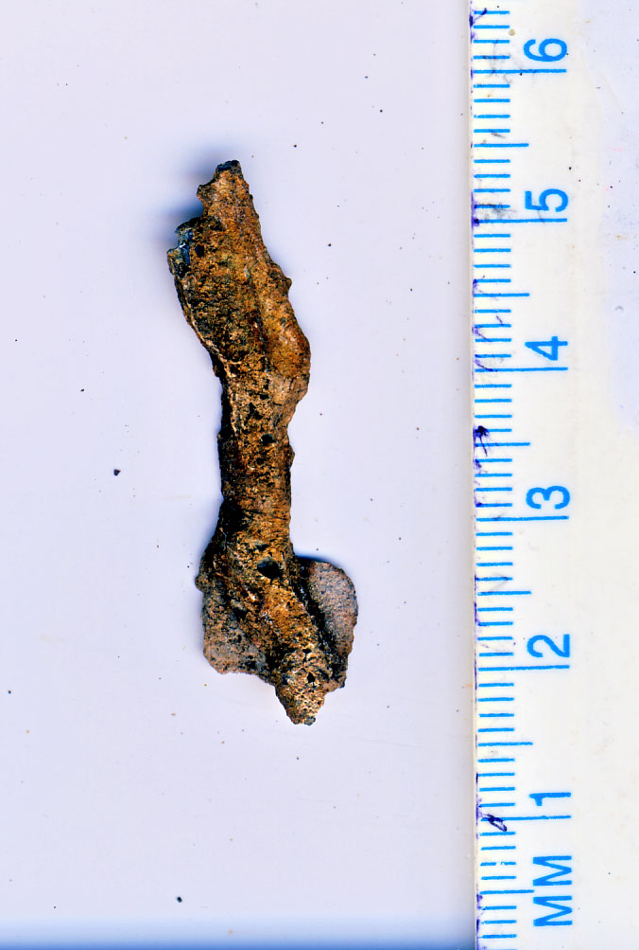
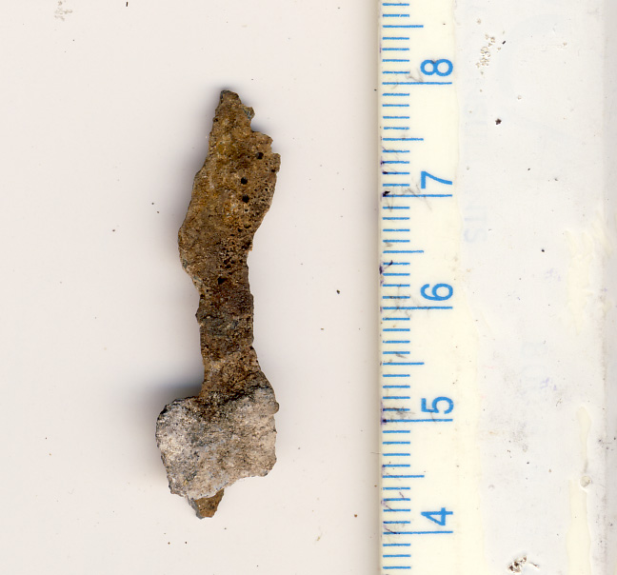
Seven Site: C-Lane Object 2010

Slide 2
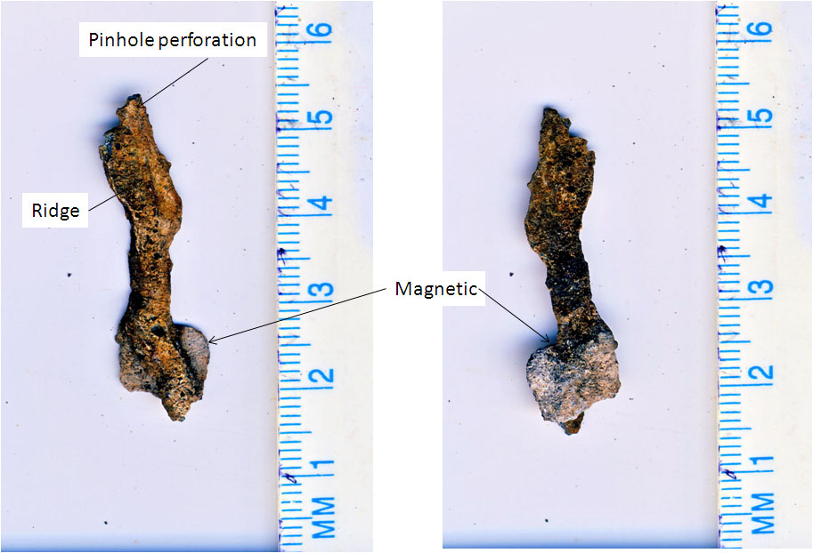

Slide 3
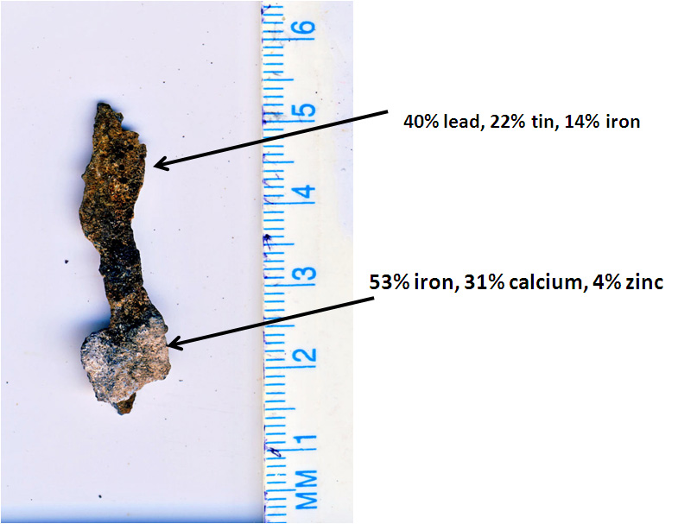

Slide 4
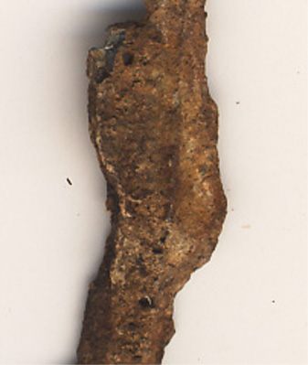
C-Lane Object:
Central Ridge
And pinholes at
500 dpi

Slide 5
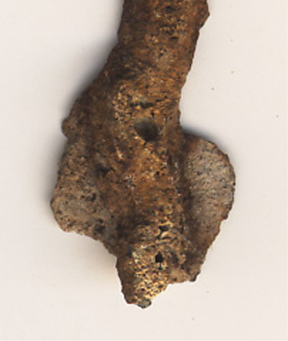
C-Lane Object:
Larger hole at
500 dpi

